Slide 1

Milestone 5
Christa Moncrief
CST-391

Slide 2
Milestone Project Goal
“Product” Supported on MySQL
CRUD Operations
REST API
Biblical Theme (Optional)

Slide 3
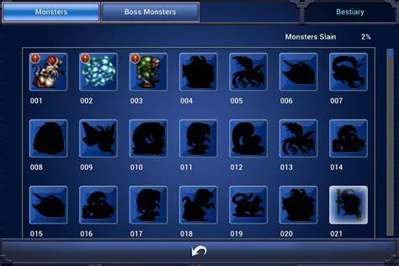
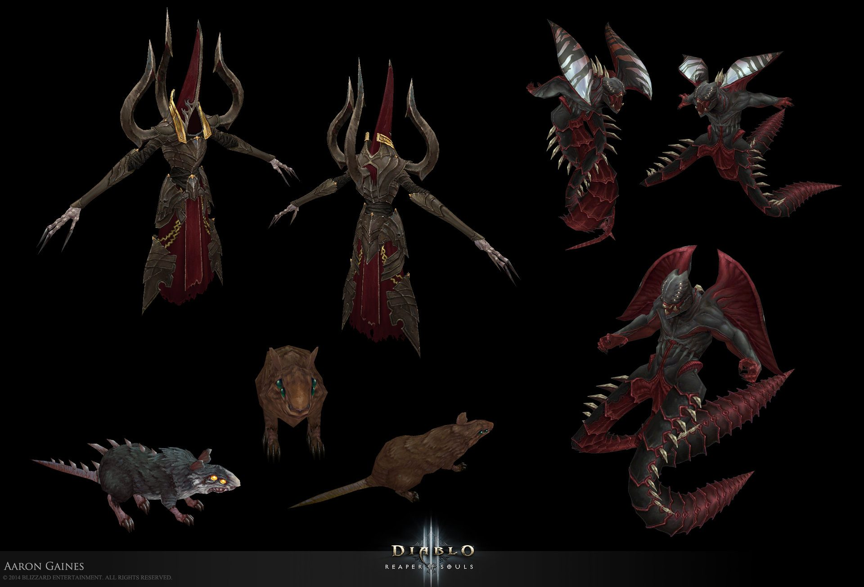
Biblical Bestiary
Final Fantasy
Diablo

Slide 4

Challenges
Time Constraints
Communication with MySQL

Slide 5
Milestone3: CreatureAPI

Slide 6
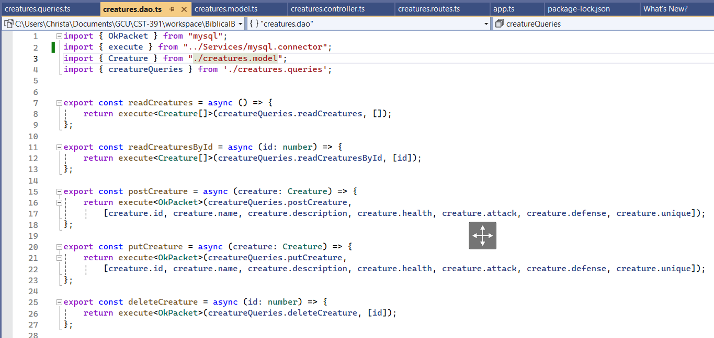
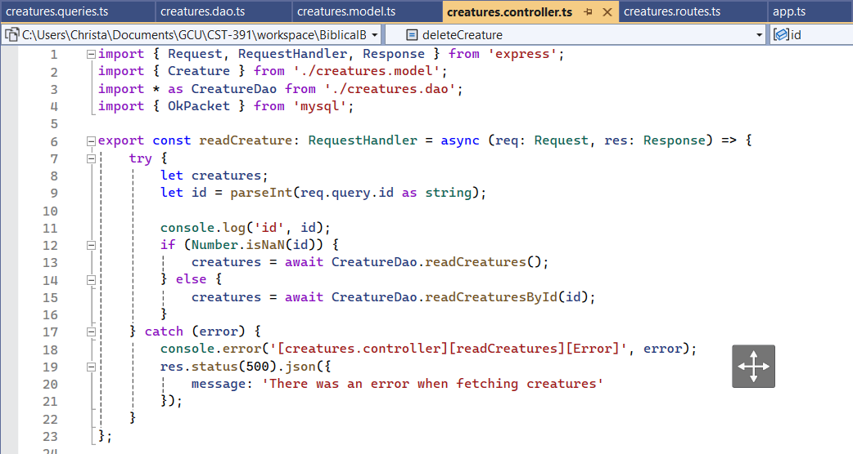
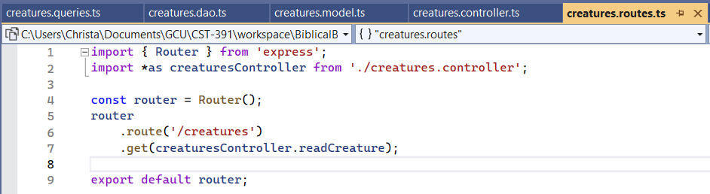
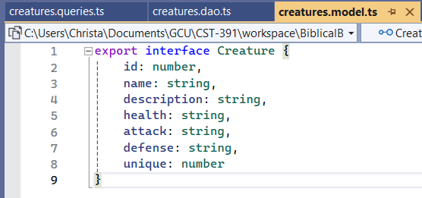
DAO
Controller
Router
Model

Slide 7
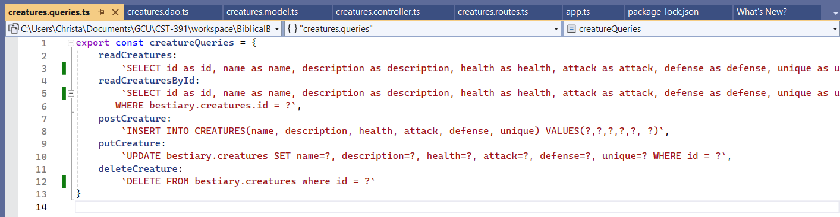
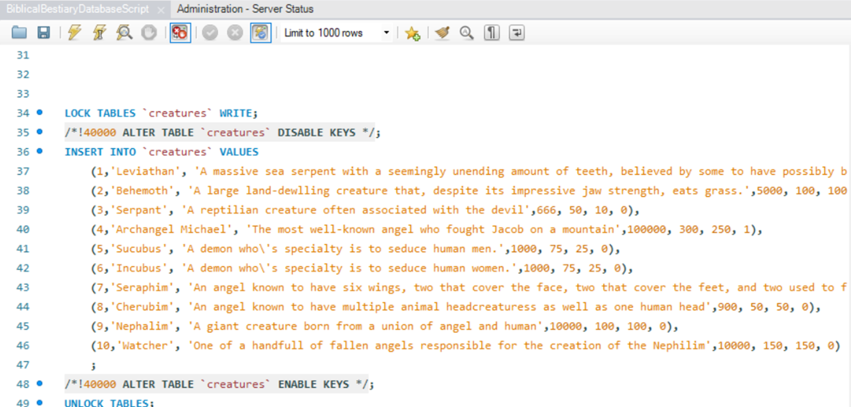

Slide 8

Pending Issues
Communication With MySQL
(Solved 2/25/2024)

Slide 9
Milestone4: Angular App

Slide 10
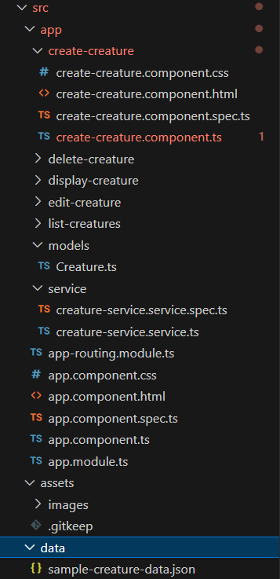
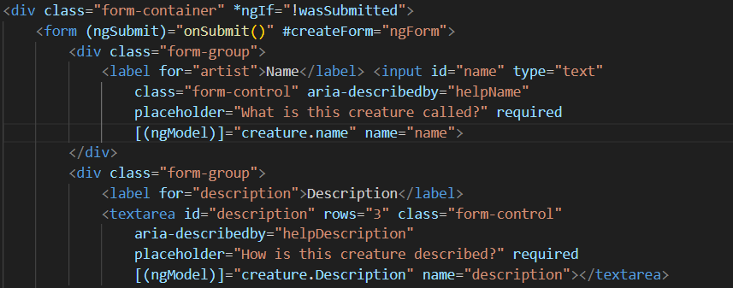
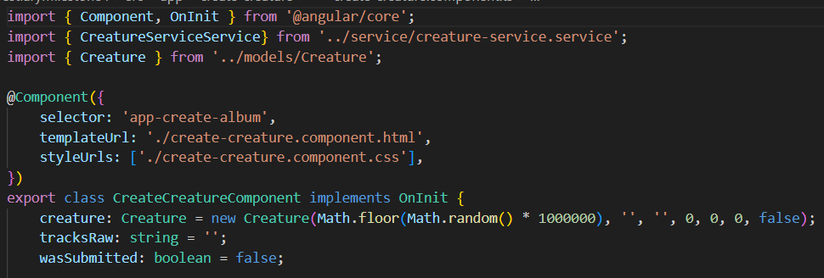
Folder Organization
HTML
Typescript

Slide 11
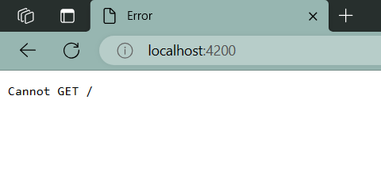
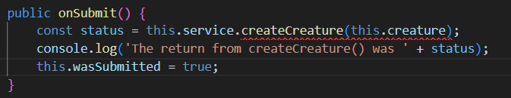
One of Many Errors
Result: Non-Functioning App

Slide 12

Pending Issues
Non-Functioning App (Unresolved)

Slide 13
Milestone5: React App

Slide 14
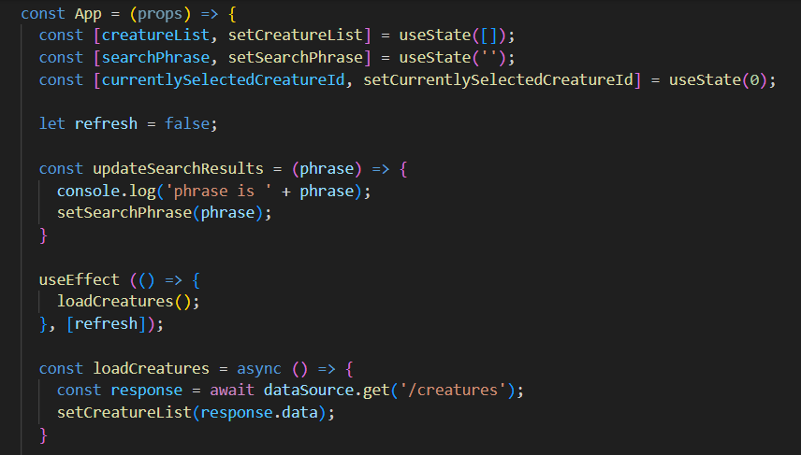
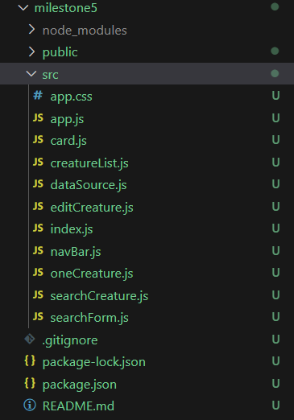
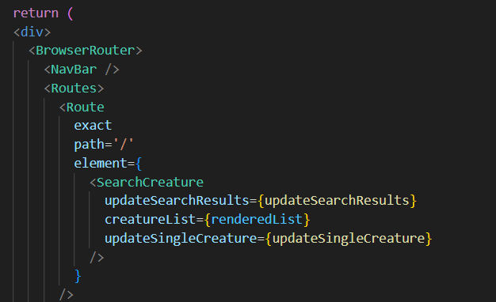
Javascript
JSX

Slide 15
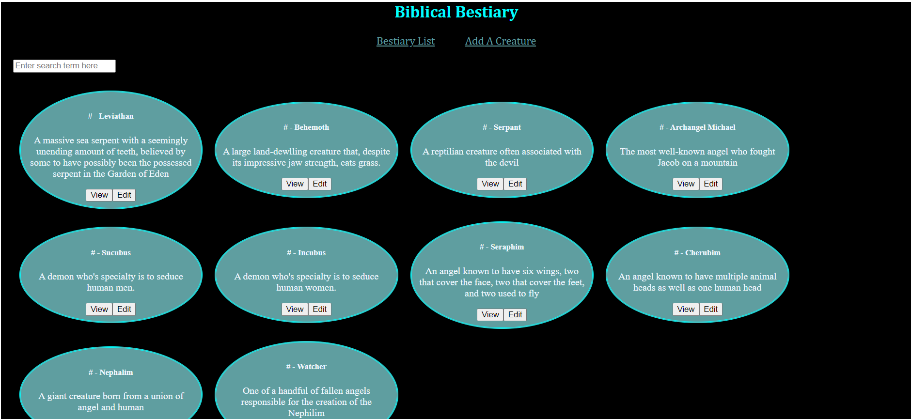
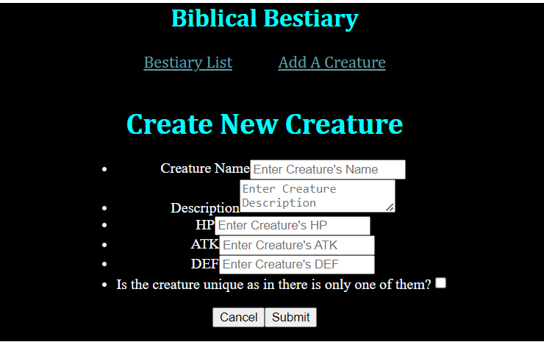
Result: (Mostly) Functional App!
https://www.youtube.com/watch?v=TC2WCcRmiqI

Slide 16
Thank You!

